Slide 1
Using 3D Glasses to tie together Ray Optics, Wave Optics, and Color Mixing
Zachary J. Rohrbach
Avon High School

Slide 2
Sources
Robertson, W. C. (2003). Light (Stop Faking It: Finally Understanding Science So You Can Teach It). Arlington, VA: NSTA Press.
MIT-Harvard Center for Ultracold Atoms. TOPS: Teaching Opportunities in Physical Science.

Slide 3
Lab Goals & Advatages
Ties light & optics together concepts
Builds understanding from the ground up
Real-World Application
Students enjoy it

Slide 4
Materials
White Paper
3D Glasses
Crayola Colored Pencils
Sky Blue
Red

Slide 5
Blue pic
Red pic
Blue pic
Red pic
What you see

Slide 6
Physics
Rules!

Slide 8
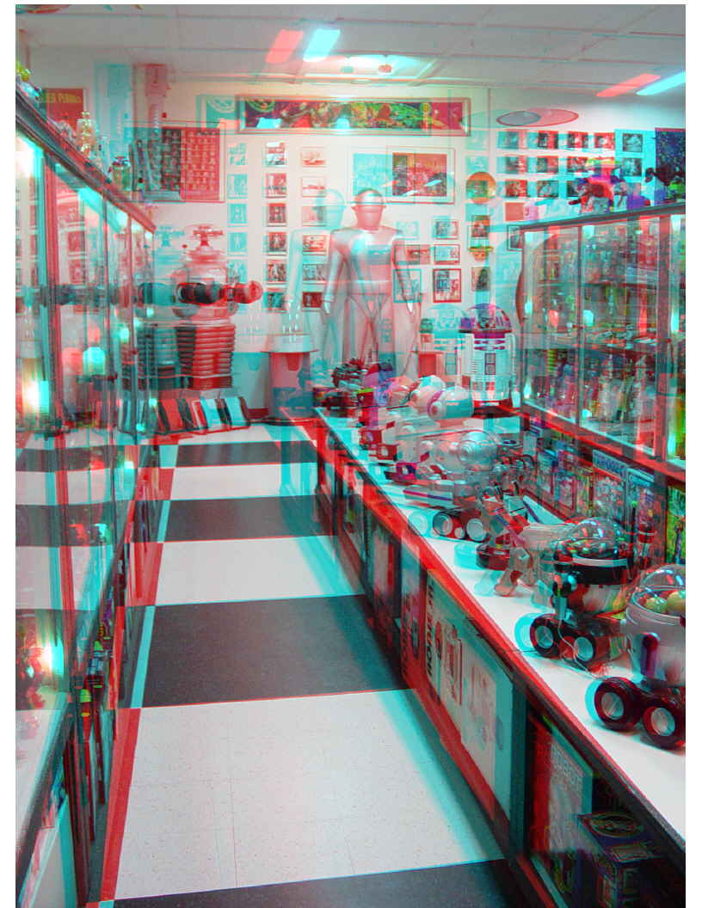

Slide 9
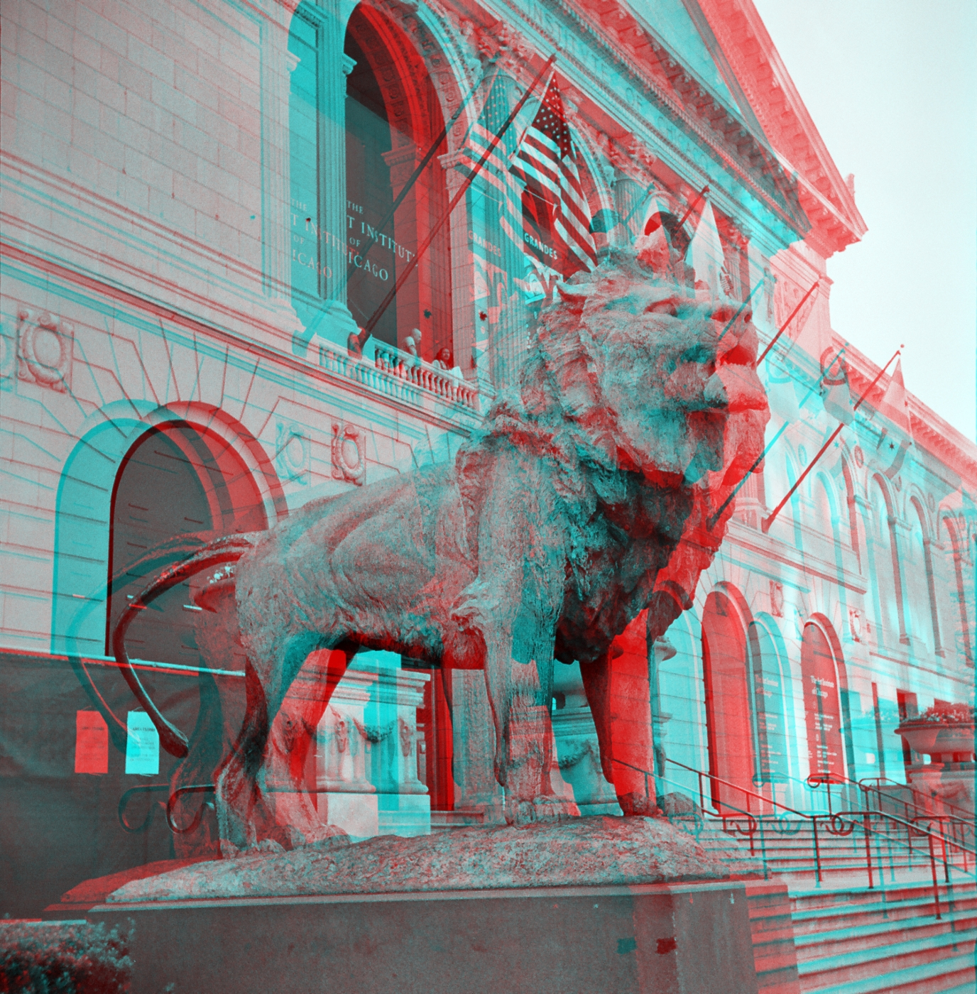

Slide 10
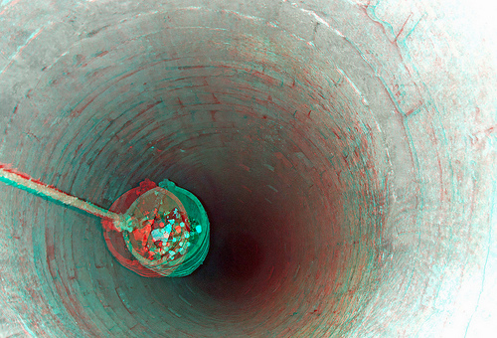

Slide 12
When an image …
“pops out”

Slide 13
When an image …
“pops in”

Slide 14
Other Cool Questions
Why do we see colored after-images after wearing the glasses for a while?
Why does the red filter work so much better than the blue filter?
How do 3D glasses in the movie theaters work?
What are the advantages of using polarized light?

Slide 15
Topics Covered
Colors
Black and White
Behavior of light through filters
Optics
“Real” and “virtual” images
Wavelengths of light

