Slide 1
Building thinking (Physics) Classrooms
Applying Peter Liljedahl’s Principles to the Physics Classroom
Zach Rohrbach
Avon High School
AAPT-IN Spring Meeting 2026

Slide 2
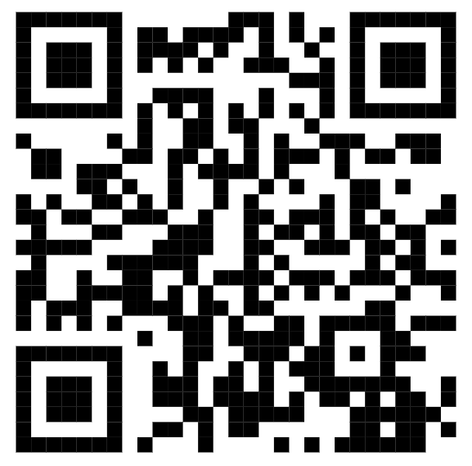
Links to tools and resources
https://www.rohrbachscience.com/btc/

Slide 3
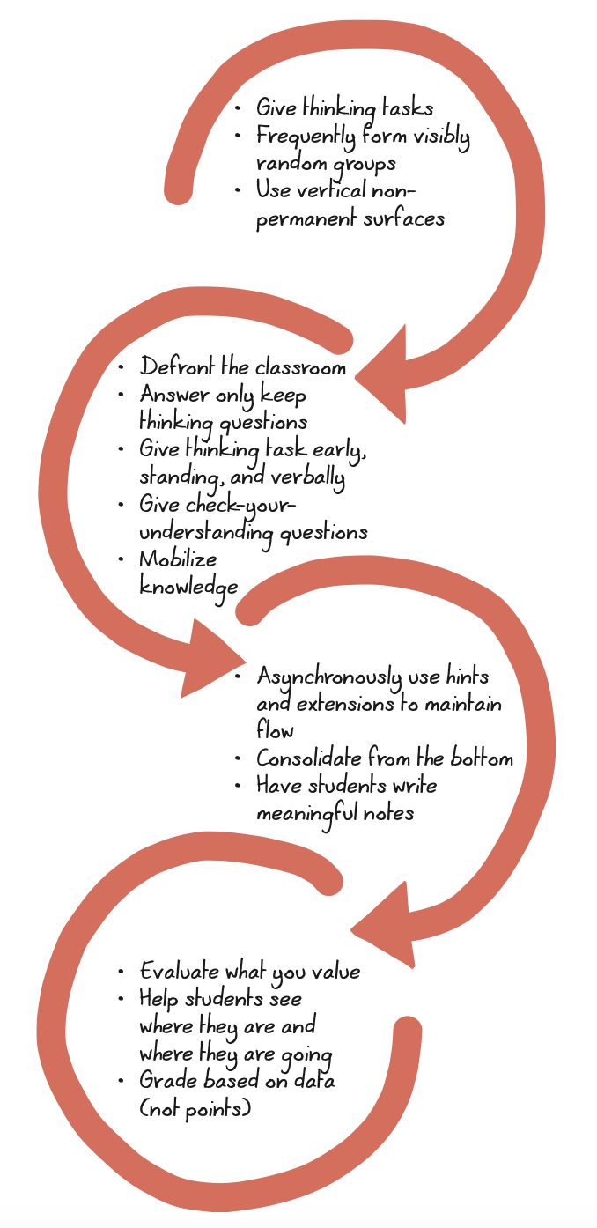
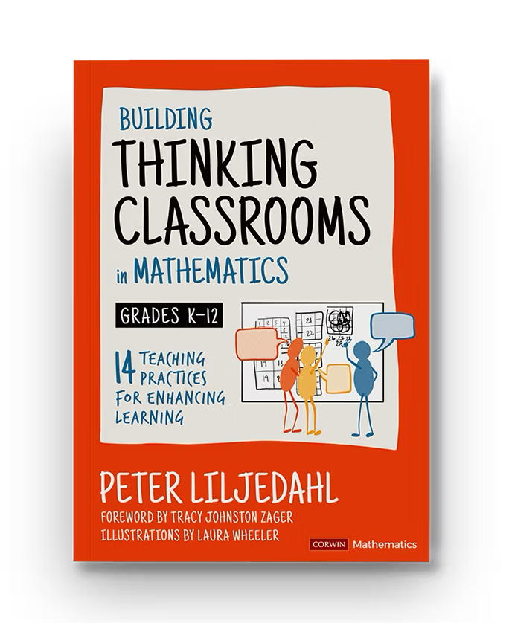
THE BOOK
At AHS, the math department did a book study a few years ago.
Last year we had an interdisciplinary PD cohort discuss this.

Slide 4
Why I’ve Enjoyed this Process
I have more of a chance to get to know students as a class instead of the individuals I spend the most time helping.
It’s much more fun than doing teacher-led practice
Students get to do the mundane algebra-y plug-and-chug-y stuff and I get to teach the more interested, physics-specific stuff.
Generally positive student feedback
Has reinvigorated my working relationships with physics teacher colleagues of 10+ years.

Slide 5
MY THREE PRACTICES
RANDOMIZED GROUPS
VERTICAL WHITEBOARDS
"CONSOLIDATOIN FROM THE BOTTOM"

Slide 6
Randomized Groups
This was my entrance into the Building Thinking Classrooms discussion
Groups of 3 is ideal
Students need to experience that it's random
Builds classroom rapport among students, not just between students and me

Slide 7
Methods for Randomizing Groups
Name Tents
Team Picker Wheel
Starting with icebreakers

Slide 8
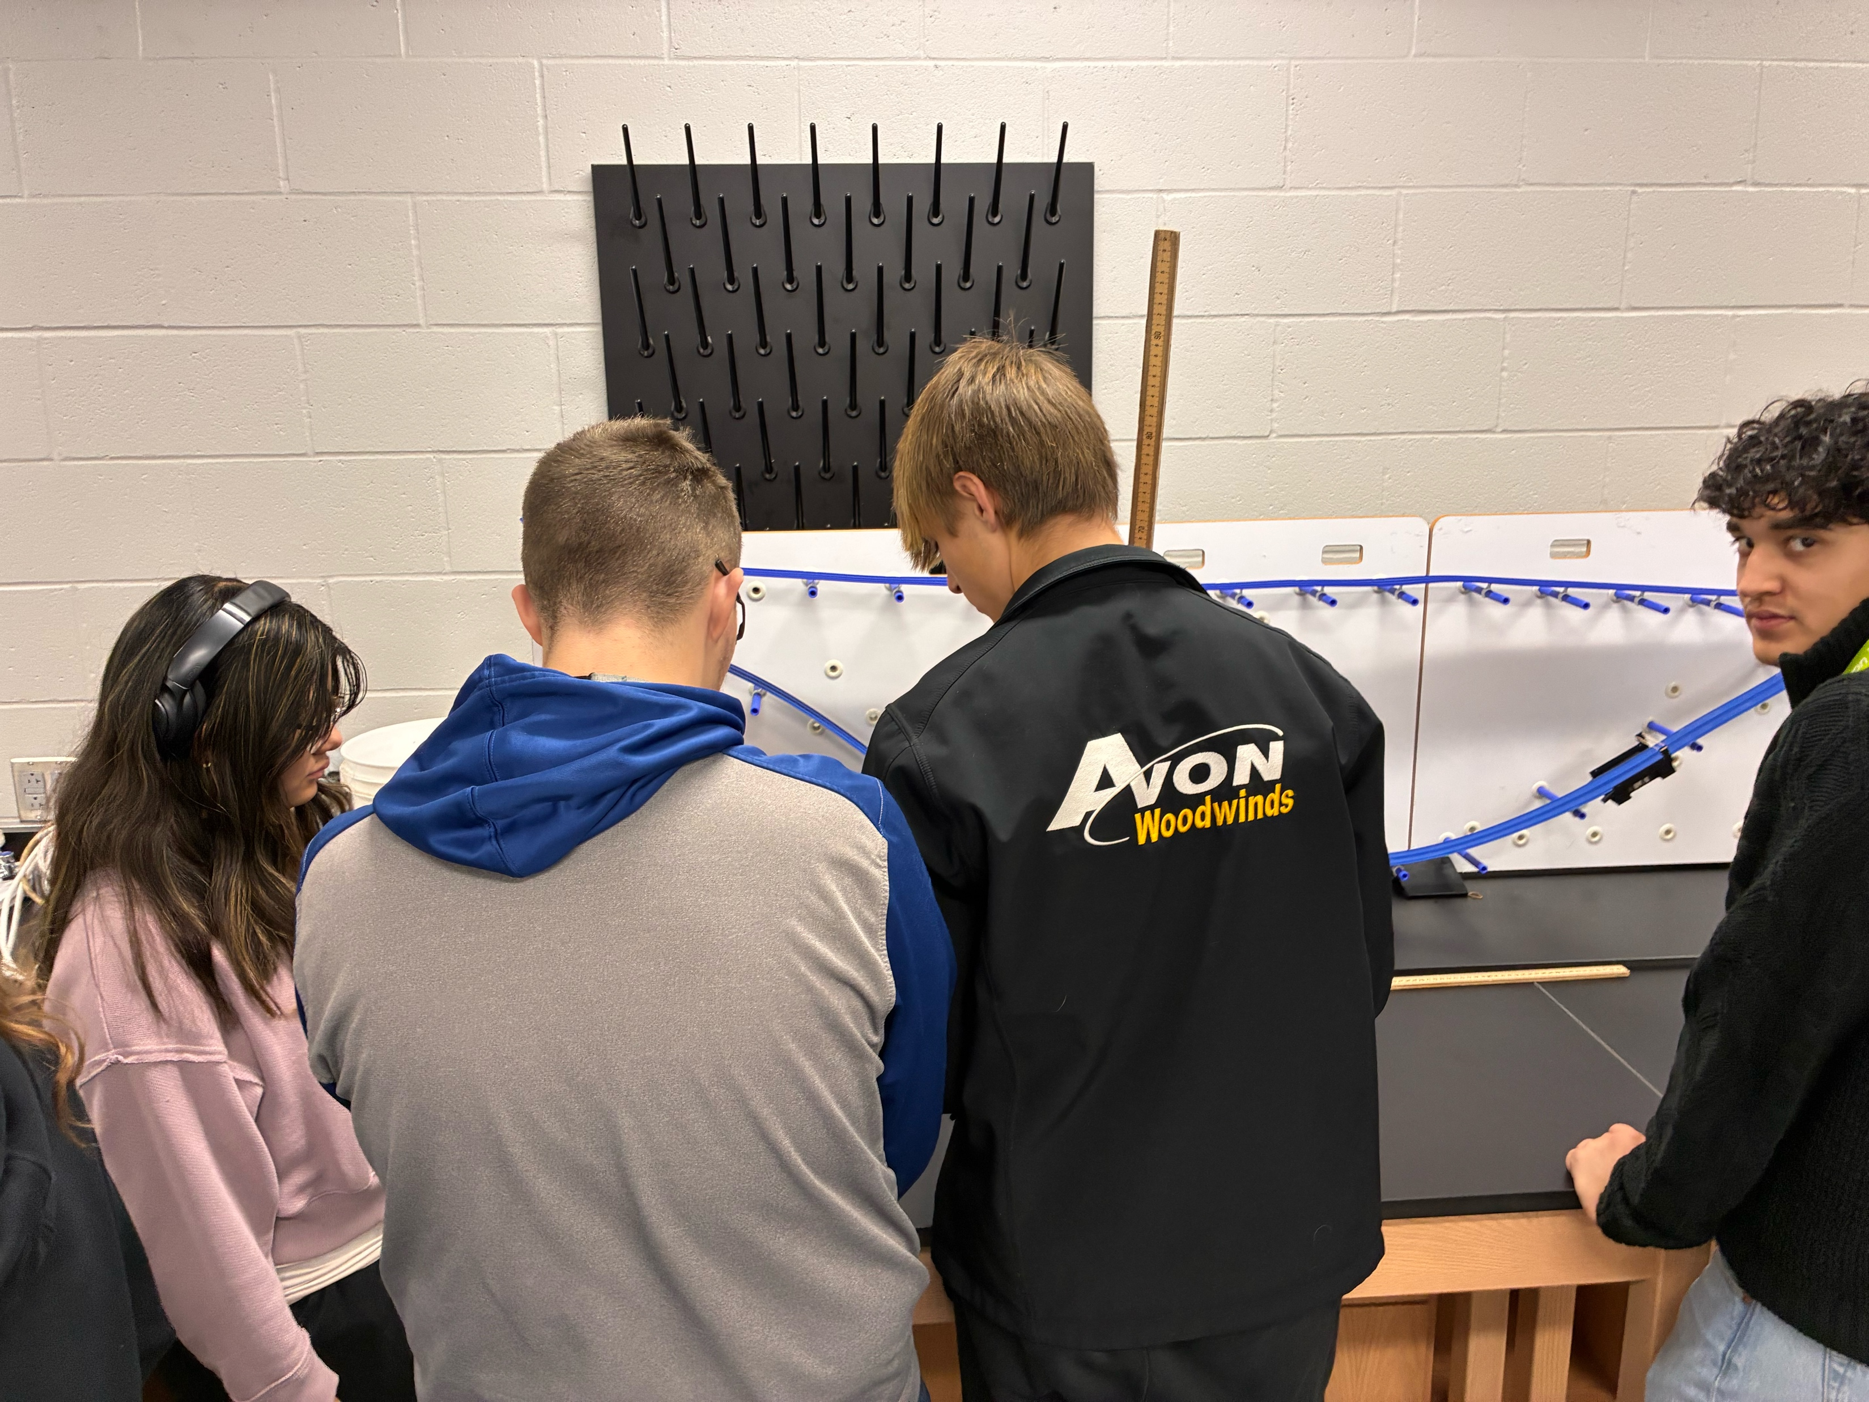
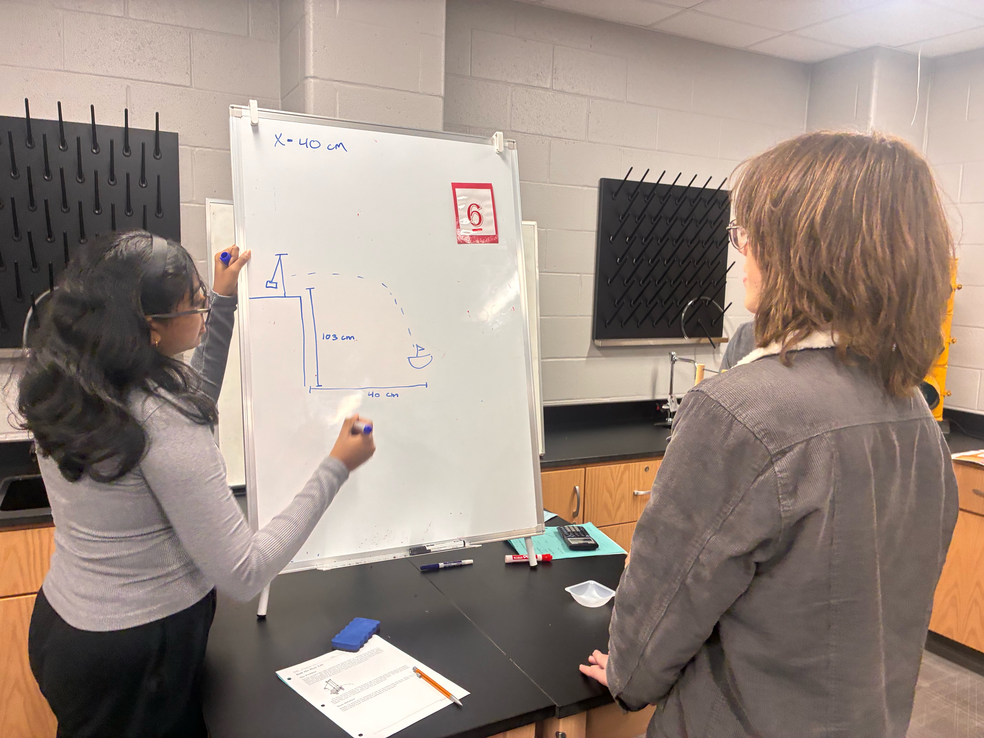
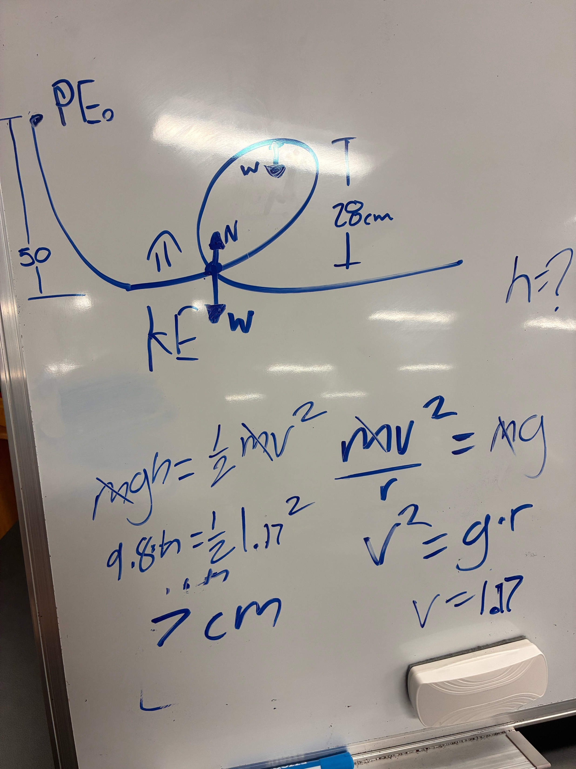
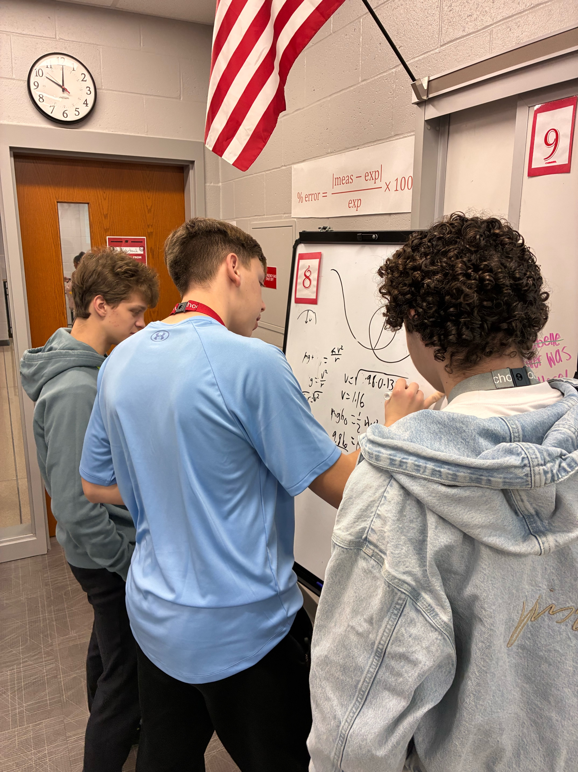
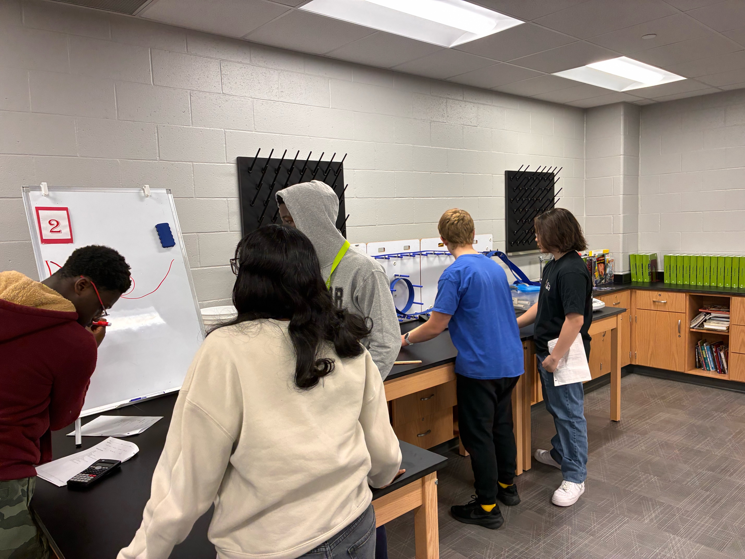
Vertical Whiteboards

Slide 9
Vertical Whiteboards
Visualize thinking
Naturally collaborative
Lends itself to quick checking on groups
Encourages mistakes
”Non-Permanent Vertical Surfaces (NPVS)”

Slide 10
My Thinking Task Expectations
1) Groups are always random.
2) Stay standing at your whiteboard.
3) Stay at your station, and do not wander.
4) Each person should write something down.
5) You’re a group, not random individuals.
If you don’t like your group, you’ll get a new one next time!
Mr. Rohrbach will circulate and answer your questions.
Everyone should be participating!
Do not sit behind your whiteboard!
The person with the idea does not always need to be the same person that writes the idea down.

Slide 11
“Consolidation from the Bottom”
Students first get a “Task Card” with one problem at a time written on it.
Groups of 3 at whiteboards
I go around and give hints
One task at a time
3 tasks prepared; I expect everyone to do two
Students get the same problems on a worksheet that we go over together
This paper will be their ”notes”
They’ve done the algebra already and can call out answers
“You’ve already figured this out and can do it. What we are doing together is developing a way to organize your work for when you see similar problems in the future”

Slide 12
Room for Improvement and Giving Myself Grace
I have to compare it to engagement in a “regular” lesson, not to perfection
I’ve made progress, but I need to stay on top of making sure certain students don’t dominate and others don’t hide
Different challenges in Honors Physics vs. Regular Physics

Slide 13
Links to tools and resources
https://www.rohrbachscience.com/btc/

